Slide 1
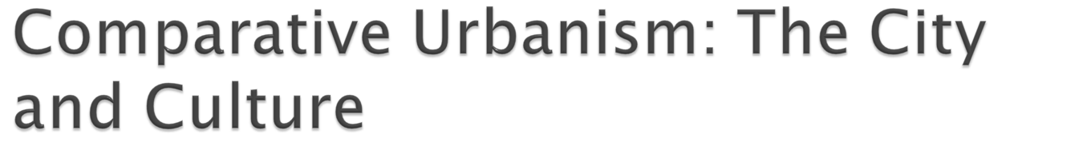
In the urban way of life, the many different types of people have found an appropriate form of public behavior that enables them to get along with one another (civic culture, Daniel J. Monti ).
All cities reflect and intensify the world’s culture.

Slide 2

Clifford Geertz---”an historically transmitted pattern of meanings embodied in symbols, a system of inherited conceptions expressed in symbolic forms by means of which men communicate, perpetuate, and develop their knowledge about and attitudes towards life.”

Slide 3

In any location, city and countryside are interdependent.
Much of city population came from the countryside.
Reciprocal shaping of lifestyles (NY’s Hasidic Jews, Asian Americans, Hispanic Americans).
Rural influence in arts, music, literature.

Slide 4

Louis Wirth—concentration of industrial, commercial, financial, and administrative facilities………
The first daily newspaper (Philadelphia, 1784), the first stock exchange (New York, 1792), the first telephone system (Boston, 1877).
Paris controlled the nation’s economic, intellectual, and political lifeblood(Liberty, Equality, Brotherhood).

Slide 5

Oswald Spengler(1880-1936) German Philosopher: The “Soul” of the City—human civilization takes on distinctive qualities in the city, “world history is city history” and the countryside is just a “landscape.” (Rome, Baghdad, Paris).
Lewis Mumford (187-1952): The City as the Center of Civilization---city is the very center of Western civilization. As time and technology improved, Shrine(burial ground) to Camp to Village to Town. At a certain point, the cultural ideas, the people, and the places are jelled as the city emerged. Culture “writ large”, not necessarily progress.

Slide 6
Daniel J. Monti: The Civic Culture of the City----Cities continue to inspire both a public spirit and a civic mindedness among their inhabitants. Civic culture (the maintenance of cooperation and coexistence in the city).
Civic culture is found in “ceremonies, customs, and codes for appropriate public behavior.” To be together in public and carry out private life ( for example, a bus line). P.236

Slide 7
The City has a unique power to intensify and symbolize culture.
Civic culture to share and practice.
Any city will dynamically and intensely reflect the characteristics of its surrounding culture.

Slide 8

During 13th century, when the Yuan (Mongol) emperor ruled China, Kublai khan transformed Beijing (Peking) into a capital city. In 1368, Ming Dynasty established. The emperor Young Lo expanded the city and turned into the city a monument to all Chinese culture.
The city within the city. 25 square miles in area separated by southern(most population), northern(walls), and imperial(forbidden) city (focus of religious and political power).

Slide 9

Peking was based on Chinese cosmology. The center of heaven, Chinese believed, was the North Star. On earth, everything revolved around the “Son of Heaven,” the emperor. As the northernmost major city of China, Peking became the emperor’s capital.
The color of the represents the status of residents (the color of roofs--green, red, purple).

Slide 10
Peking was a symbolic world, a whole city built on the cultural themes of harmony with nature, security, and power. Just like all other stars revolved around Northern Pole star, Forbidden City becomes the center of the universe and heaven.
Each “layer of onion” led to the vital, the omnipotent center, emperor.

Slide 11
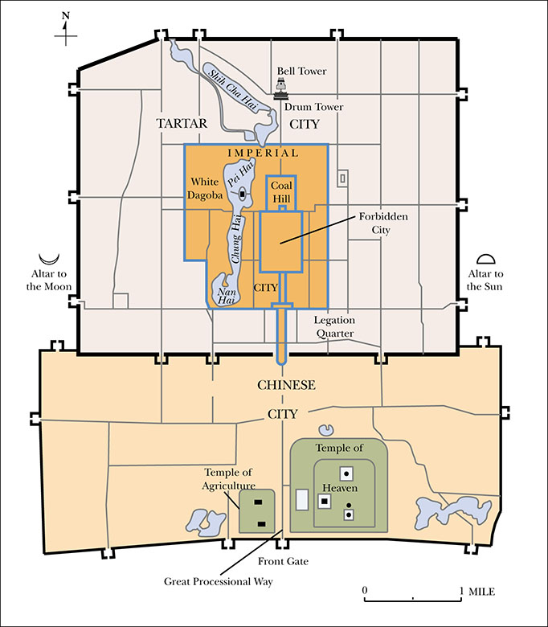
Figure 9.1: Ming Beijing
Notes:
City within a city
Outer city
Tartar city
Imperial city
Forbidden City

Slide 12
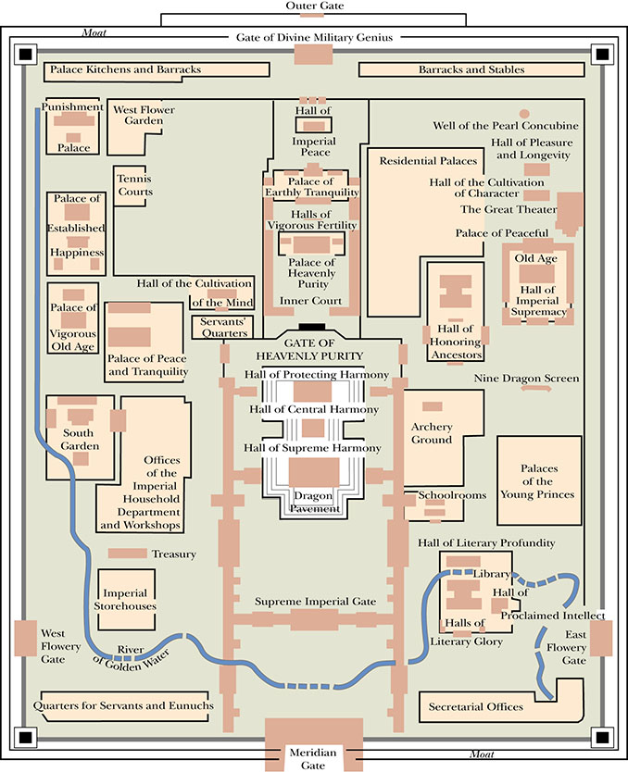
Figure 9.2: The Forbidden City

Slide 13

Since its founding 2,000 B.C.E., it came under the control of feudal overlords who called themselves aristoi (“the best people”). By the 8th century B.C.E., these overlords ruled several hundred independent Greek city-states (poli).
Wealthy middle class and warrior class earned its name tyrannos.

Slide 14

In 600 B.C.E., Solon, an aristocrat, proposed a reorganization of the Athenians constitution that allowed all “free citizens” (excluding women, slaves, and foreigners) a place in the city’s governing body, the Assembly. He established the People’s Council (400).
Philosophy (Socrates, Plato). All citizens strives for refinement. Olympic games.

Slide 15

One-fourth of the city’s population were slaves. All women relegated to household duties and supervision.
Athenians denied citizenship to foreigners, mostly traders. By 4th century B.C.E., profit making had become the center of city life.
In 338 B.C.E, the Athens collapsed by Macedonian, and Romans conquered them in 148 B.C.E..

Slide 16

1) The feudal order of the Middle Ages began to erode as merchant , in the cities, gained power. Since 16th century capitalism set the principal cultural term.
2) economic activity became competitive.
James watt’s steam engine
Invention of factory
Capitalism and industrialism created a new emphasis in urban consciousness.

Slide 17

Beijing today, along with other Chinese cities, has embraced capitalistic enterprise and city life flourishes with individual enterprises.
Opium War in 1839, Sino-Japanese War in 1895, the Boxer Rebellion of 1900. In 1911, Dr. Sun Yat-sen overthrow Ching dynasty and built a Chinese Republic, Chiang Kai-shek succeeded in 1927. 1948, the People’s Republic of China occupied Peking.

Slide 18
Groupthink—conformity to opinions that supposedly reflect group consensus. The control of individuals(not any other countries?).
It is now world-class economy at the expense of pollution and central rules (early industrial cities of London, Paris, and Baltimore…..).
Deng Xiao Ping—economic reform after Mao’s death in 1976. Pollution and the rising consumerism problems.

Slide 19

Charlemagne(774-814)---The first emperor of Holy Roman empire
Louis XIV (1643-1715)---- “Sun King”, age of absolutism. Palace of Versailles (forced nobility to reside in the palace)
Tokugawa Japan(1603-1868)—the rule of shogunate until the Meiji Restoration in 1868

Slide 20

Urban dominance over the country.
A city, symbolic center, is a relatively large, dense settlement that has a civic culture and a complex social structure that greatly reflects, intensifies, and recreates cultural values and forms.
Differences of cities highlights the importance of culture in shaping the social and physical environment.

